Slide 1

Interacting With Oracle
By
Krishnaprakash N
GBS IT Innovation Quality

Slide 2
Retrieving Data : Syntax
Retrieve data from the database with SELECT.
  SELECT select_list
  INTO variable_name
  FROM table
  WHERE condition;
INTO clause is required.
Exactly one row must be returned.
Full SELECT syntax is available.

Slide 3
SELECT statements in PL/SQL
The INTO clause is required.
Queries must return one and only one row.
Example :
DECLARE
  V_deptno emp.deptno%TYPE;
  V_ename emp.ename%TYPE;
  BEGIN
  SELECT deptno,ename
  INTO v_deptno,v_ename
  FROM emp
  WHERE empno =7844;
  DBMS_OUTPUT.PUT_LINE(‘ Employee Name =‘|| v_ename );
  END;

Slide 4
Manipulating Data Using PL/SQL
Make changes to database tables by using DML commands:
  INSERT
  UPDATE
  DELETE
  MERGE

Slide 5
Inserting Data
Add new employee information to the EMPLOYEES table.
Example
  BEGIN
  INSERT INTO employees(empno,ename,sal)‏
  VALUES
  (1,'Sella',100000);
  END;

Slide 6
Updating Data
Increase the salary of all employees who are ANALYST.
Example
  DECLARE
  v_sal_increase emp.sal%TYPE :=800;
  BEGIN
  UPDATE emp
  SET sal = sal + v_sal_increase
  WHERE job = 'ANALYST';
  END;

Slide 7
Composite Data Types
Are of two types
  PL/SQL RECORDS
  PL/SQL Collections
    INDEX BY Table
    Nested Table
    VARRAY

Slide 8
PL/SQL Records
A record is a group of related data items stored in fields, each with its own name and data type
Must contain one or more components of any scalar, RECORD, or INDEX BY table data type,called fields
Are similar in structure to records in a third generation language (3GL)‏
Are not the same as rows in a database table, Treat a collection of fields as a logical unit
Are convenient for fetching a row of data from a table for processing

Slide 9
Creating a PL/SQL Record
Syntax:
  TYPE type_name IS RECORD
  (field_declaration[, field_declaration]...);
  identifier type_name;
  Where field_declaration is:
  field_name {field_type | variable%TYPE
  | table.column%TYPE | table%ROWTYPE}
  [[NOT NULL] {:= | DEFAULT} expr]
Example:
  TYPE emp_record_type IS RECORD
  (last_name VARCHAR2(25),
  job_id VARCHAR2(10),
  salary NUMBER(8,2));
  emp_record emp_record_type;

Slide 10
Creating an INDEX BY Table
Syntax:
  TYPE type_name IS TABLE OF
  {column_type | variable%TYPE
  | table.column%TYPE} [NOT NULL]
  | table%ROWTYPE
  [INDEX BY BINARY_INTEGER];
  identifier type_name;
Declare an INDEX BY table to store names.
Example:
  TYPE ename_table_type IS TABLE OF
  employees.last_name%TYPE
  INDEX BY BINARY_INTEGER;
  ename_table ename_table_type;

Slide 11
Using INDEX BY Table Methods
A INDEX BY table method is a built-in procedure or function that operates on tables and is called using dot notation.
EXISTS(n) - Returns TRUE if the nth element in a PL/SQL table exists
COUNT - Returns the number of elements that a PL/SQL table currently contains
FIRST - Returns the first and last (smallest and largest) index numbers in a
LAST PL/SQL table. Returns NULL if the PL/SQL table is empty.
PRIOR(n) - Returns the index number that precedes index n in a PL/SQL table
NEXT(n) - Returns the index number that succeeds index n in a PL/SQL table
TRIM - TRIM removes one element from the end of a PL/SQL table.
DELETE - DELETE removes all elements from a PL/SQL table.

Slide 12
Example :INDEX BY Table of Records
SET SERVEROUTPUT ON
DECLARE
TYPE emp_table_type is table of
employees%ROWTYPE INDEX BY BINARY_INTEGER;
my_emp_table emp_table_type;
v_count NUMBER(3):= 104;
BEGIN
FOR i IN 100..v_count
LOOP
SELECT * INTO my_emp_table(i) FROM employees
WHERE employee_id = i;
END LOOP;
FOR i IN my_emp_table.FIRST .. my_emp_table.LAST
LOOP
DBMS_OUTPUT.PUT_LINE ( my_emp_table(i).last_name );
END LOOP;
END;

Slide 13
Cursors
Every SQL statement executed by the Oracle Server has an individual cursor associated with it:
  Implicit cursors
    Declared for all DML and PL/SQL SELECT statements
  Explicit cursors
    Declared and named by the programmer
A cursor is a private SQL work area
The oracle server uses implicit cursors to parse and execute your SQL statements

Slide 14
Implicit Cursor Attributes
Using SQL cursor attributes, you can test the outcome of your SQL statements.
SQL%ROWCOUNT
  Number of rows affected by the most recent SQL statement
SQL%FOUND
  Boolean attribute that evaluates to TRUE if the most recent SQL statement affects one or more rows.
SQL%NOTFOUND
  Boolean attribute that evaluates to TRUE if the most recent SQL statement does not affect any rows.
SQL%ISOPEN
  Always evaluates to FALSE because PL/SQL closes implicit cursors immediately after they are executed.

Slide 15
SQL Cursor Attributes
Delete rows that have the specified employee ID from the EMP table . Print the number of rows deleted.
    Declare
    V_empno Emp.empno%type := 7844;
    Begin
    DELETE FROM emp
    WHERE empno = v_empno;
    Dbms_output.put_line(SQL%ROWCOUNT ||' row deleted.');
    End;

Slide 16
Explicit Cursor
Controlling Explicit Cursors Using Four Command
  Declare the cursor
  Declare the cursor by naming it and defining the structure of the query to be
  performed within it.
  Open the cursor
  The OPEN statement executes the query and binds any variables that are
  referenced. Rows identified by the query are called the active set and are
  now available for fetching.
  Fetch data from the cursor
  The FETCH statement loads the current row from the cursor into
  variables. Each fetch causes the cursor to move its pointer to the next
  row in the active set.
  Close the cursor
  The CLOSE statement releases the active set of rows. It is now possible
  to reopen the cursor to establish a fresh active set.

Slide 17
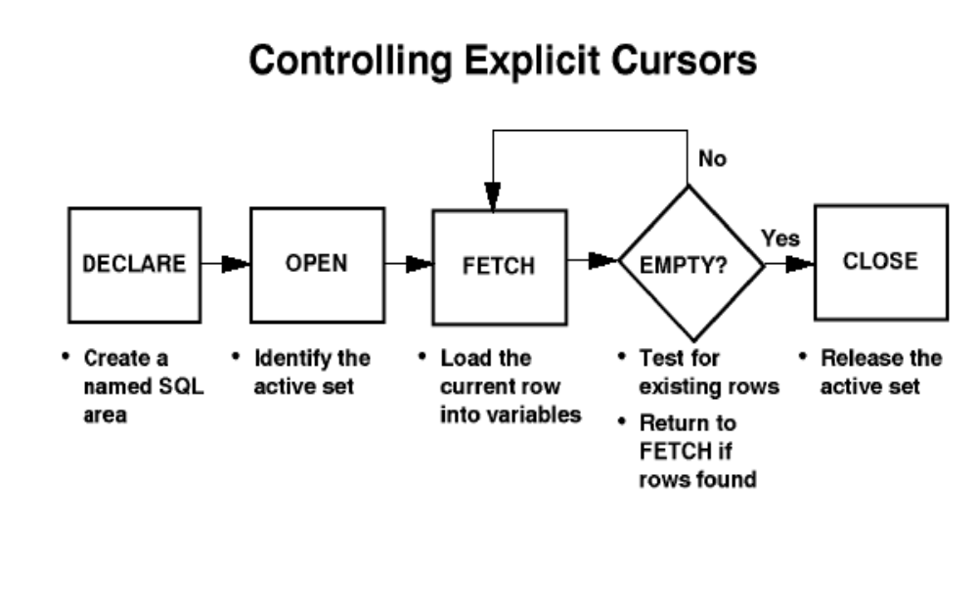
Controlling Explicit Cursors

Slide 18
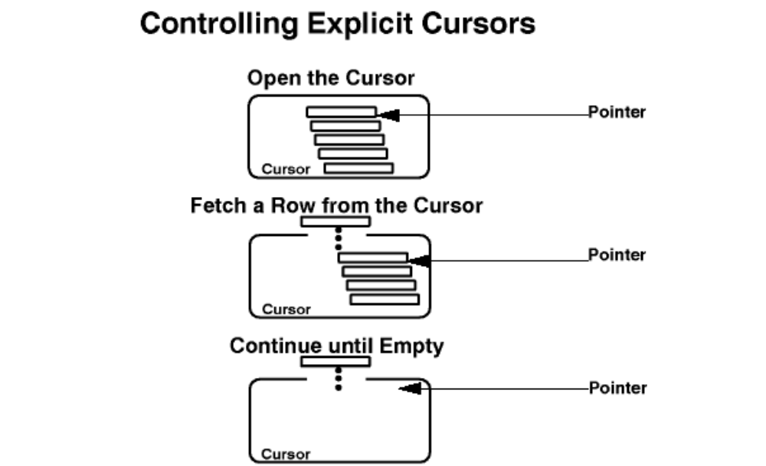
...Controlling Explicit Cursors

Slide 19
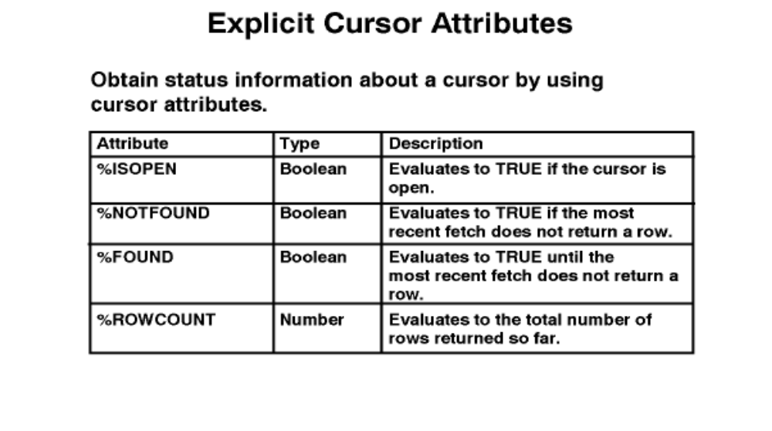
Cursor Attributes

Slide 20
Example : Explicit Cursor
Retrieve the first five line items for an Employee’s one by one.
  Declare
  v_deptno Emp.deptno%type;
  v_empno Emp.empno%type;
  v_ename Emp.ename%type;
  v_sal Emp.sal%type;
  CURSOR Emp_cursor IS
  SELECT Empno, ename , Salary FROM emp
  WHERE deptno = v_deptno;
  BEGIN
  V_deptno := &deptno;
  OPEN Emp_cursor;
    LOOP
      FETCH emp_cursor INTO v_empno, v_ename,v_sal;
      EXIT WHEN emp_cursor%ROWCOUNT > 5 OR emp_cursor%NOTFOUND;
      DBMS_OUTPUT.PUT_LINE(v_empno ||’-’|| v_ename ||’-’||v_sal);
    END LOOP;
    CLOSE emp_cursor;
  END;

Slide 21
Cursors with parameter
Use parameters to open an explicit cursor several times in a block, returning a different active set on each occasion.
CURSOR cursor_name [(parameter_name datatype, ...)]
IS
select_statement;

Slide 22
Cursor FOR Loops
Use cursor FOR loops as a shortcut to open the cursor, fetch rows once for each loop iteration, and automatically close the cursor after all rows are processed
    FOR record_name IN cursor_name LOOP
    statement1;
    statement2;
    END LOOP;
Guidelines
  Do not declare the record that controls the loop. Its scope is only in the loop.
  Test the cursor attributes during the loop, if required.
  Supply the parameters for a cursor, if required, in parentheses following the cursor name in the FOR statement.
  Do not use a cursor FOR loop when the cursor operations have to be handled manually.

Slide 23
Example : Cursor FOR Loop
Example :
  DECLARE
  CURSOR Emp_cur IS
  SELECT Empno FROM emp WHERE deptno=10;
  BEGIN
    FOR emp_rec IN emp_cur
    LOOP
    Update emp
    Set sal = sal + 500
    Where empno = emp_rec.empno;
    END LOOP;
  END;
  /

Slide 24
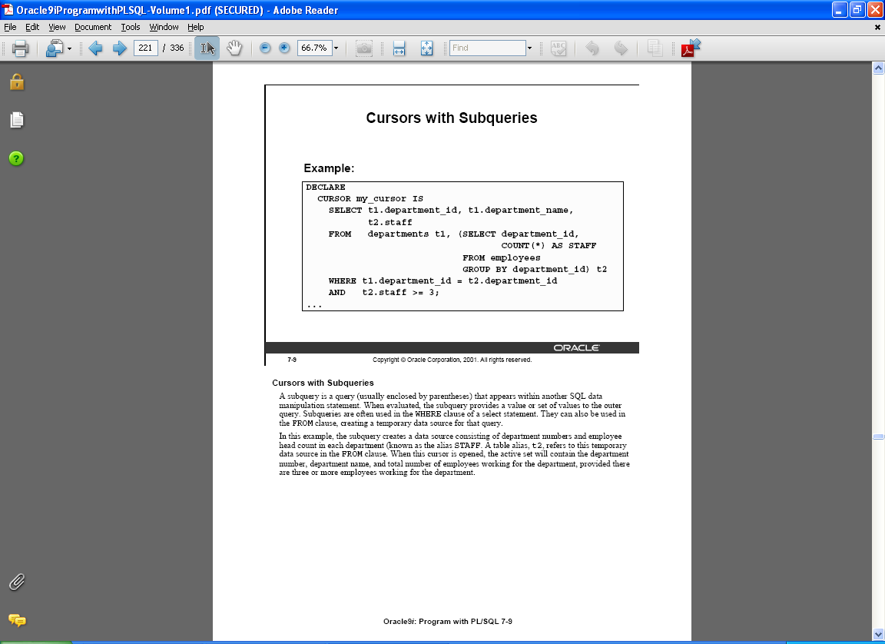
Cursors With Subqueries

Slide 25
The FOR UPDATE Clause
Syntax:
SELECT ...
FROM
FOR UPDATE [OF column_reference] ;
Use explicit locking to deny access for the duration of transaction.
Lock the rows before the update or delete.

Slide 26
Example : FOR UPDATE
DECLARE
  CURSOR emp_cursor IS
  SELECT Empno,ename
  FROM emp
  WHERE deptno=20
  FOR UPDATE OF sal;
  emp_rec emp_cursor%rowtype;
BEGIN
  OPEN emp_cursor;
  LOOP
  FETCH emp_cursor into emp_rec;
  EXIT WHEN emp_cursor%NOTFOUND;
  update emp
  set sal =sal + 500
  where empno=emp_rec.empno;
  END LOOP;
END;

Slide 27
Thank You

